Slide 1
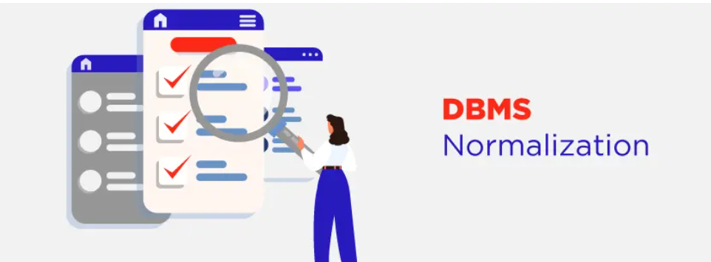

Slide 2
Data duplication could occur in a large database defined as a single relation. This data repetition could lead to the following:
Expanding relationships greatly.
Maintaining and updating data is difficult since it necessitates searching through numerous related entries.
Waste and inefficient use of resources and disc space.
Errors and inconsistencies are more likely to occur.

Slide 3
Normalization is the process to eliminate data redundancy and enhance data integrity in the table.
It is performed to reduce the data redundancy in a database and to ensure that data is stored logically.
Data redundancy in DBMS means having the same data but at multiple places.
It is necessary to remove data redundancy because it causes anomalies in a database which makes it very hard for a database administrator to maintain it.

Slide 4
Why Do We Need Normalization?
Normalization is the aim of well design Relational Database Management System (RDBMS).
It is step by step set of rules by which data is put in its simplest forms.
We normalize the relational database management system because of the following reasons:

Slide 5
Minimize data redundancy i.e. no unnecessarily duplication of data.
To make database structure flexible i.e. it should be possible to add new data values and rows without reorganizing the database structure.
Data should be consistent throughout the database i.e. it should not suffer from following anomalies.

Slide 6
A database anomaly is a flaw in the database that occurs because of poor planning and redundancy.
Insertion anomalies: This occurs when we are not able to insert data into a database because some attributes may be missing at the time of insertion.
Updation anomalies: This occurs when the same data items are repeated with the same values and are not linked to each other.

Slide 7
Deletion anomalies: This occurs when deleting one part of the data deletes the other necessary information from the database.
Normalization is a method to remove all these anomalies and bring the database to a consistent state.

Slide 8
ADVANTAGES OF NORMALIZATION
The following are the advantages of the normalization.
More efficient data structure.
Avoid redundant fields or columns.
More flexible data structure i.e. we should be able to add new rows and data values easily
Better understanding of data.
Ensures that distinct tables exist when necessary. Minimizes data duplication.

Slide 9
The main objectives of normalization are:
Eliminating Data Redundancy:
Redundant data storage can lead to inconsistencies and anomalies.
Normalization aims to minimize data duplication by breaking down tables into smaller, more atomic units.

Slide 10
Ensuring Data Integrity: (Accuracy, completeness, consistency)
By eliminating redundancy and organizing data properly, normalization helps maintain the integrity of the data. It reduces the chances of update anomalies, where inconsistencies or inaccuracies can occur due to redundant data.
Facilitating Querying and Maintenance:
Normalization simplifies data retrieval and modification by structuring data into logical relationships.
It helps to improve the efficiency of database queries and makes it easier to update, insert, or delete data.

Slide 11
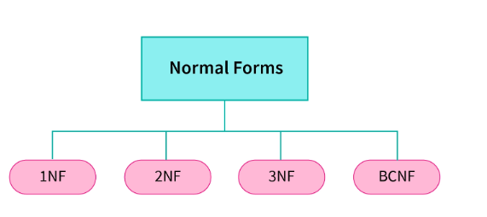
Normal Forms
There are four types of normal forms that are usually used in relational databases

Slide 12
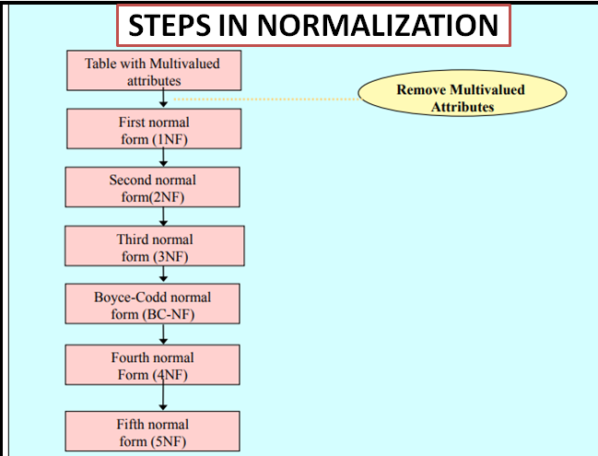

Slide 13
First Normal Form (1NF)
A relation is in 1NF if every attribute is a single-valued attribute or it does not contain any multi-valued or composite attribute, i.e., every attribute is an atomic attribute.
If there is a composite or multi-valued attribute, it violates the 1NF.

Slide 14
Each table cell can only contain one value.
This means that any point where two rows or columns meet must contain atomic values.
For instance, each entry for a column with the name and phone number must only save one phone number.

Slide 15
If a relation doesn't have any multi-valued attributes, it is said to be in 1NF (first normal form).
In other terms, a relation is said to be in 1NF if each attribute only includes atomic (single) values.

Slide 16
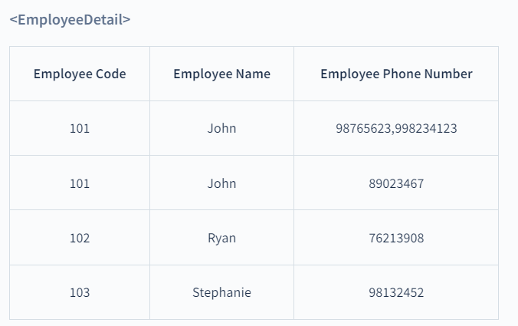
Let’s take an example of a relational table <EmployeeDetail> that contains the details of the employees of the company.

Slide 17
Here, the Employee Phone Number is a multi-valued attribute. So, this relation is not in 1NF.
To convert this table into 1NF, we make new rows with each Employee Phone Number as a new row as shown below:

Slide 18
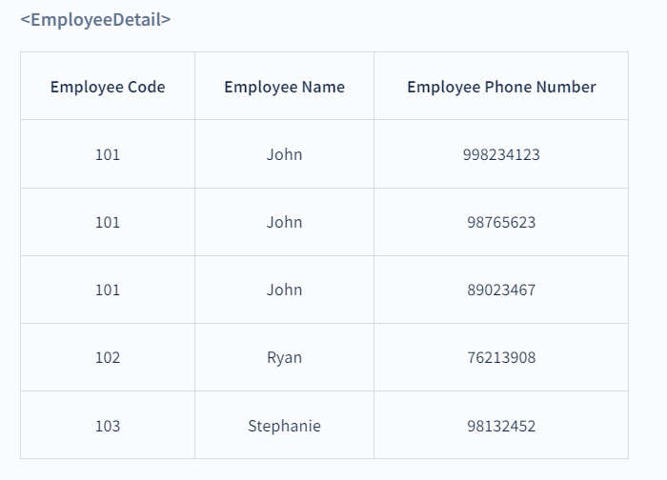

Slide 19
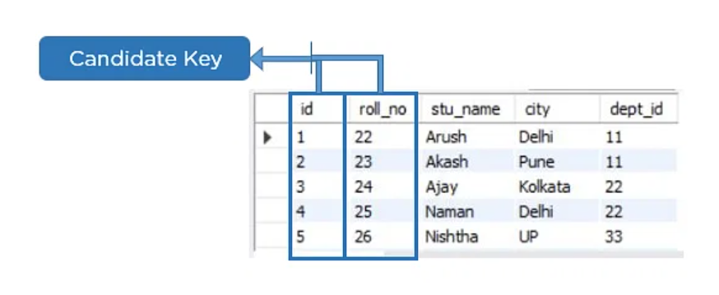
Candidate Key
A candidate key is a set of one or more columns that can identify a record uniquely in a table, and YOU can use each candidate key as a Primary Key.

Slide 20
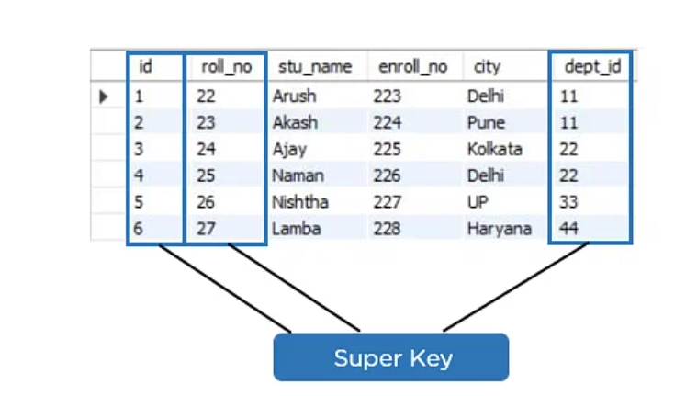
Super Key
Super key is a set of over one key that can identify a record uniquely in a table, and the Primary Key is a subset of Super Key.

Slide 21
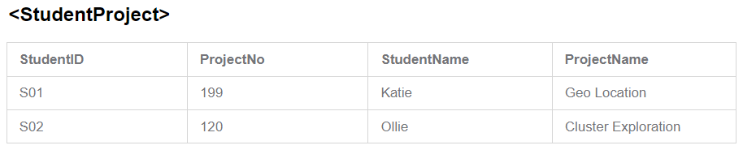
What is Partial Dependency?
Partial Dependency occurs when a non-prime attribute is functionally dependent on part of a candidate key.
The prime key attributes are StudentID and ProjectNo
the non-prime attributes i.e. StudentName and ProjectName should be functionally dependent on part of a candidate key, to be Partial Dependent.

Slide 22
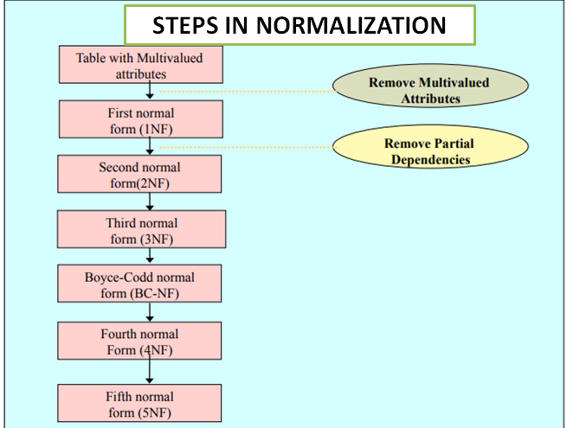

Slide 23
2NF (Second Normal Form)
The first condition for the table to be in Second Normal Form is that the table has to be in First Normal Form.
Every non-key attribute is fully functionally dependent on the ENTIRE primary key.
The table should not possess partial dependencies.
The reduction of partial dependencies is necessary for the normalization of 1NF relations to 2NF.

Slide 24
It must be completely functionally dependent on the primary key, with no partial dependencies allowed.
If there is a partial dependency, we can split the table in two and relocate the partially dependent characteristics to another table where they will fit in better.
let's use the following "EmployeeProjectDetail" table.

Slide 25
Because Employee Code may identify Employee Name and Project Name can be determined by Project ID, we have partial dependencies in this table.
As a result, the relational table mentioned above breaks the 2NF constraint.
The EmployeeProjectDetail table can be divided into the following three tables to eliminate partial dependencies and normalize it into the second normal form:

Slide 26
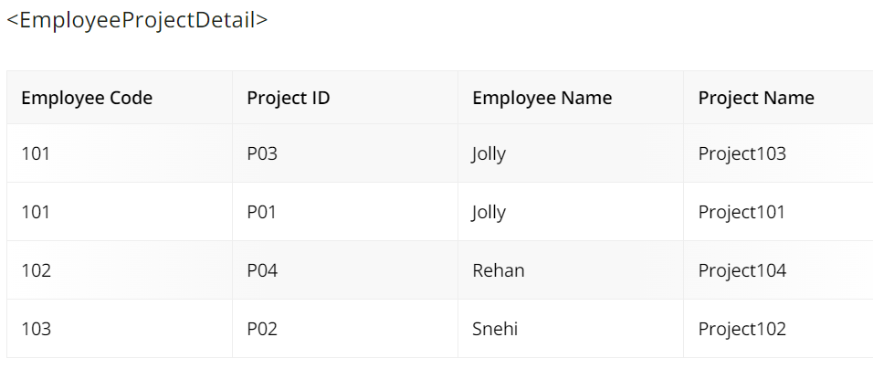

Slide 27
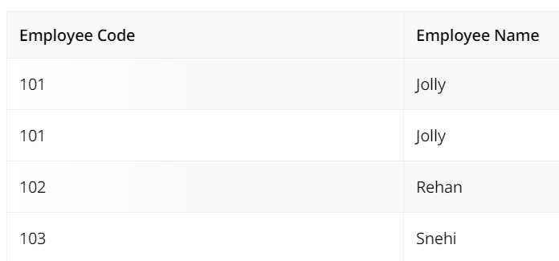
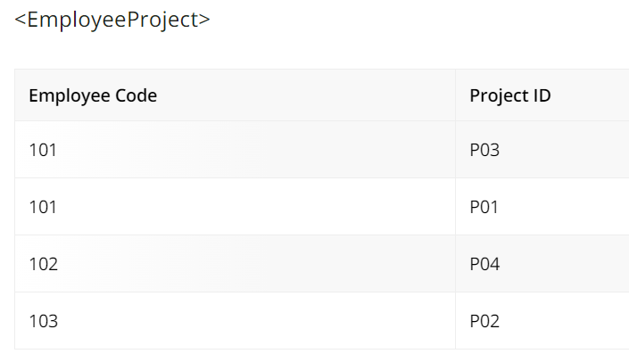

Slide 28
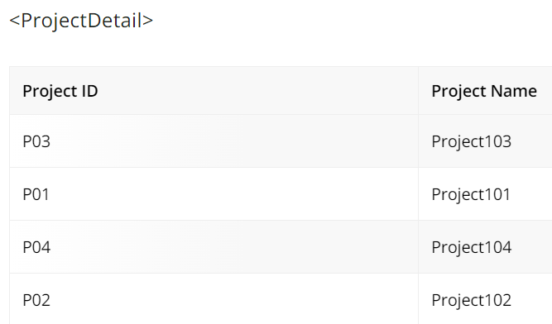

Slide 29
By splitting the EmployeeProjectDetail database into the EmployeeDetail, ProjectDetail, and EmployeeProject tables, we were able to convert it into 2NF.

Slide 30
Determining the Candidate Keys i.e.,
Finding the Candidate Keys
R(A,B,C)
FD’s are A->B B->C
{A,B,C,AB,BC,CA,ABC}
To find the Candidate Key
We need to find the Closure of the attributes
The Closure of the attributes are
(A)+ ={A,B,C}
(B)+={B,C}
(C)+={C}
(AB)+={A,B,C}
(BC)+={B,C}
(CA)+={C,A,B}
(ABC)+={A,B,C}

Slide 31
Determining the Candidate Keys i.e.,
Finding the Candidate Keys
R(A,B,C,D)
FD’s are A->B B->C C->D D->A
1 A B C D
2 AB AC AD BC BD CD
3 ABC BCD CDA ADB
4 ABCD
To find the Candidate Key
We need to find the Closure of the attributes

Slide 32
(A)+={A,B,C,D}
(B)+={B,C,D,A}
(C)+={C,D,A,B}
(D)+={D,A,B,C}
All the A,B,C,D are the Candidate Keys.

Slide 33
Determining the Candidate Keys i.e.,
Finding the Candidate Keys
R(A,B,C,D)
FD’s are A->BC B->C D->C
1 A B C D
2 AB AC AD BC BD CD
3 ABC BCD CDA ADB
4 ABCD
To find the Candidate Key
We need to find the Closure of the attributes

Slide 34
(A)+={A,B,C}
(B)+={B,C,}
(C)+={C}
(D)+={D,C}
(AB)+={A,B,C}
(AC)+={A,B,C}
(AD)+={A,D,B,C}
(BC)+={B,C}
(BD)+={B,D,C}
(CD)+={C,D}
(ABC)+={A,B,C}
(BCD)+={B,C,D}

Slide 35
Stu_no | Course_no | Course_fee
1 | C1 | 1000
2 | C1 | 1000
3 | C2 | 1500
1 | C2 | 1500
4 | C3 | 2000
2 | C4 | 2500
2 | C3 | 2000
4 | C1 | 1000
4 | C2 | 1500
1 | C3 | 2000
Consider the table and the FD’s are
{stu_no,courseno}->course fee
{course_no}->course Fee

Slide 36
Consider the Candidate Key in the Relation
Possibilities
(Stu_no,courseno,course fee)
(stu_no,courseno)+={stu_no,courseno,coursefee}
(AB)+={A,B,C}
We need to remove the Partial dependency
So split into the AB and BC

Slide 37
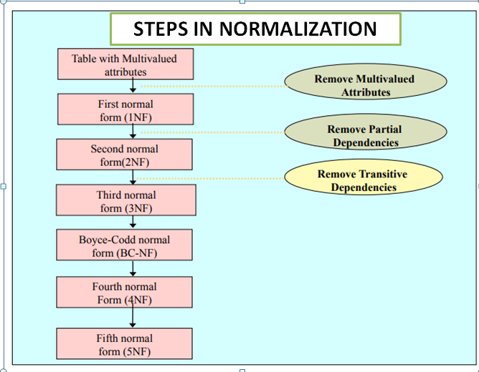

Slide 38
Third Normal Form (3NF)
The first condition for the table to be in Third Normal Form is that the table should be in the Second Normal Form.
The second condition is that there should be no transitive dependency for non-prime attributes, which indicates that non-prime attributes (which are not a part of the candidate key) should not depend on other non-prime attributes in a table.

Slide 39
A Relation schema R is in 3rd Normal Form if whenever, a non trivial Functional dependency
X-> A hold in R,
Either X is a Super key of R
A is a Prime attribute of R.
Prime attribute is the attributes involved in the Candidate Key.

Slide 40
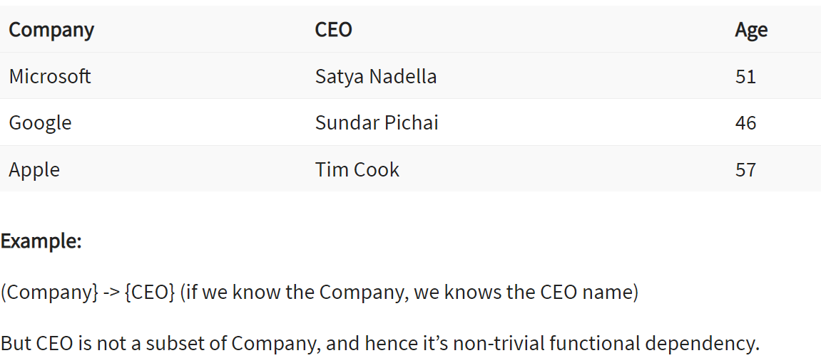

Slide 41

In the above student table, stu_id determines subid, and subid determines sub.
Therefore, stu_id determines sub via subid. This implies that the table possesses a transitive functional dependency, and it does not fulfill the third normal form criteria.

Slide 42
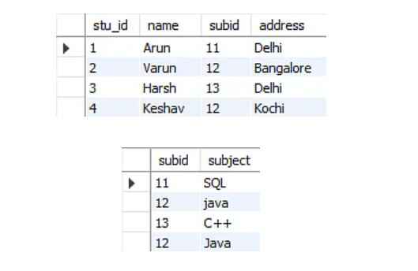
Now to change the table to the third normal form, you need to divide the table as shown below:

Slide 43
Boyce CoddNormal Form (BCNF)
Boyce Codd Normal Form is also known as 3.5 NF.
It is the superior version of 3NF and was developed by Raymond F. Boyce and Edgar F. Codd to tackle certain types of anomalies which were not resolved with 3NF.
The first condition for the table to be in Boyce Codd Normal Form is that the table should be in the third normal form. Secondly, every Right-Hand Side (RHS) attribute of the functional dependencies should depend on the super key of that particular table.

Slide 44
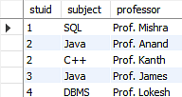
For example :
You have a functional dependency X → Y. In the particular functional dependency, X has to be the part of the super key of the provided table.

Slide 45
The subject table follows these conditions:
Each student can enroll in multiple subjects.
Multiple professors can teach a particular subject.
For each subject, it assigns a professor to the student.
In the above table, student_id and subject together form the primary key because using student_id and subject; you can determine all the table columns.

Slide 46
Another important point to be noted here is that one professor teaches only one subject, but one subject may have two professors.
Which exhibit there is a dependency between subject and professor, i.e. subject depends on the professor's name.

Slide 47
The table is in 1st Normal form as all the column names are unique, all values are atomic, and all the values stored in a particular column are of the same domain.
The table also satisfies the 2nd Normal Form, as there is no Partial Dependency.
And, there is no Transitive Dependency; hence, the table also satisfies the 3rd Normal Form.

Slide 48
stuid, and subject forms the primary key, which means the subject attribute is a prime attribute.
However, there exists yet another dependency - professor → subject.
BCNF does not follow in the table as a subject is a prime attribute, the professor is a non-prime attribute.

Slide 49
To transform the table into the BCNF, you will divide the table into two parts.
One table will hold stuid which already exists and the second table will hold a newly created column profid.

Slide 50
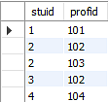

Slide 51
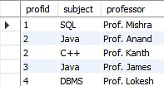
And in the second table will have the columns profid, subject, and professor, which satisfies the BCNF.

Slide 52
Fourth Normal Form (4NF)
Fourth Normal Form comes into picture when Multi-valued Dependency occur in any relation.
Rules for 4th Normal Form
For a table to satisfy the Fourth Normal Form, it should satisfy the following two conditions:
It should be in the Boyce-Codd Normal Form.
And, the table should not have any Multi-valued Dependency.

Slide 53
What is Multi-valued Dependency?
A table is said to have multi-valued dependency, if the following conditions are true,
For a dependency A → B, if for a single value of A, multiple value of B exists, then the table may have multi-valued dependency.
Also, a table should have at-least 3 columns for it to have a multi-valued dependency.

Slide 54
And, for a relation R(A,B,C), if there is a multi-valued dependency between, A and B, then B and C should be independent of each other.
If all these conditions are true for any relation(table), it is said to have multi-valued dependency.

Slide 55
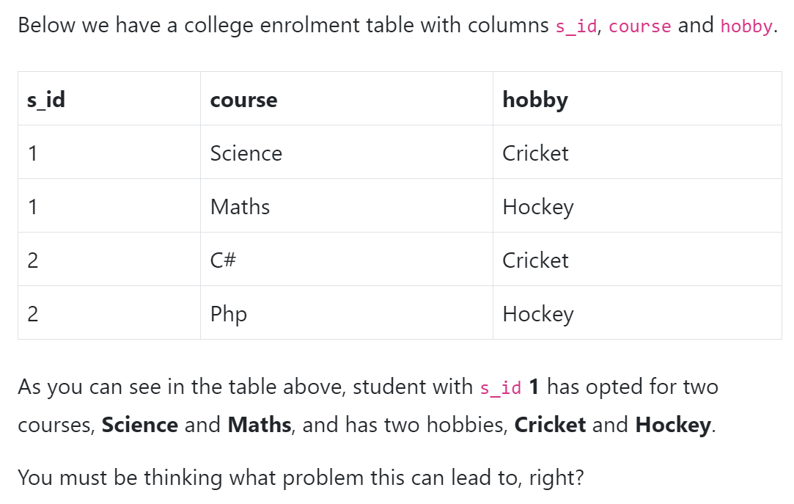

Slide 56
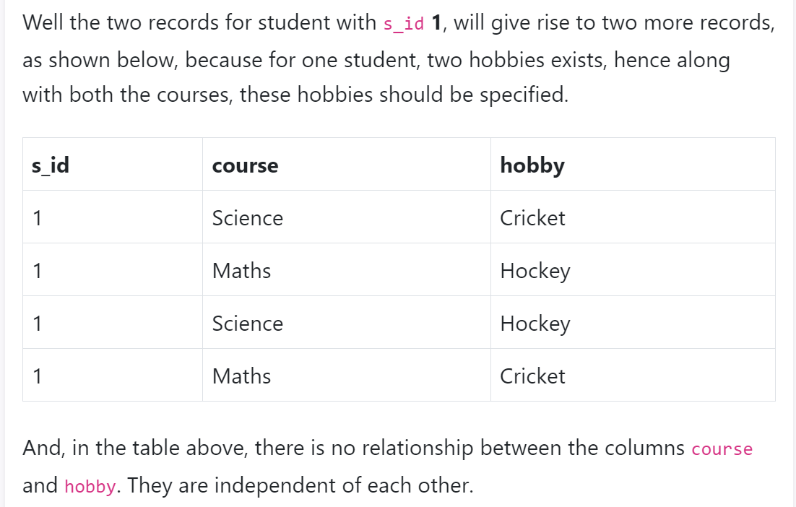
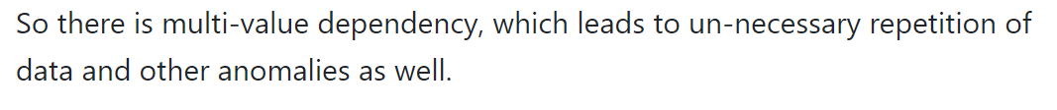

Slide 57
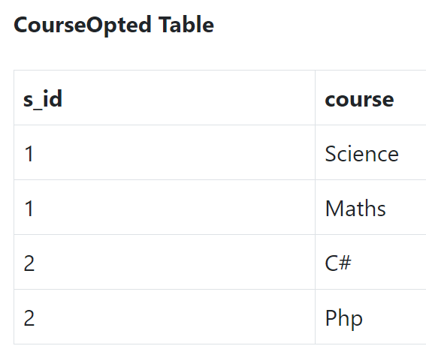
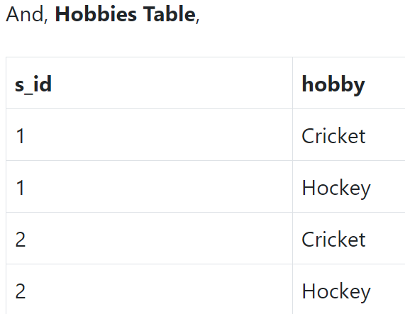
How to satisfy 4th Normal Form?
To make the above relation satify the 4th normal form, we can decompose the table into 2 tables.

Slide 58
Now this relation satisfies the fourth normal form.
A table can also have functional dependency along with multi-valued dependency. In that case, the functionally dependent columns are moved in a separate table and the multi-valued dependent columns are moved to separate tables.

Slide 59
Lab Record
SQL LANGUAGES:
NESTED QUERIES, AGGREGATE FUNCTIONS:
CO-RELATED NESTED QUERIES, RELATION ALGEBRA OPERATIONS:
QUERIES ON BOATS, SAILORS, RESERVE TABLES:
QUERIES ON STUDENT, LIBRAY
QUERIES ON STUDENT, ENROLMENT
E-R MODEL FOR ONLINE SHOPPING

Slide 60
Fifth Normal Form / Projected Normal Form (5NF):
A relation R is in 5NF if and only if every join dependency in R is implied by the candidate keys of R. A relation decomposed into two relations must have loss-less join Property, which ensures that no spurious or extra tuples are generated, when relations are reunited through a natural join.
Properties – A relation R is in 5NF if and only if it satisfies following conditions:

Slide 61
R should be already in 4NF.
It cannot be further non loss decomposed (join dependency)
Example – Consider the above schema, with a case as “if a company makes a product and an agent is an agent for that company, then he always sells that product for the company”. Under these circumstances, the ACP table is shown as:

Slide 62
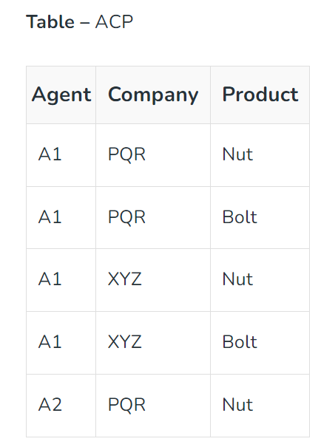

Slide 63
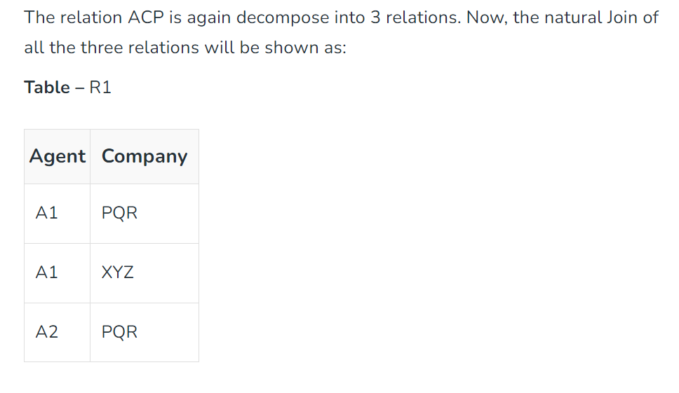

Slide 64
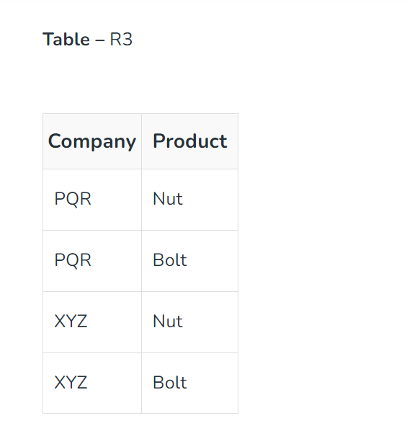
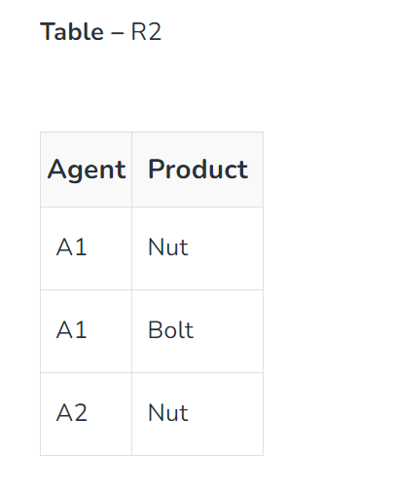

Slide 65
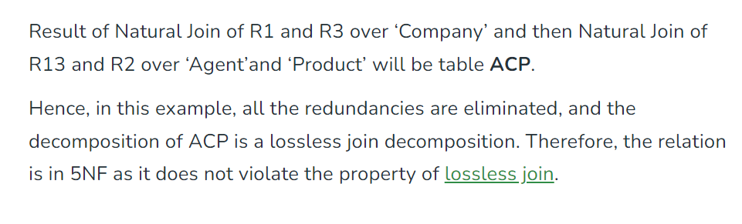

Slide 66
MID 1 Paper solutions
(PART – A)
List Various Data models:
  Hierarchical Model.
  Network Model.
  Entity-Relationship Model.
  Relational Model.
  Object-Oriented Data Model.
  Object-Relational Data Model.

Slide 67

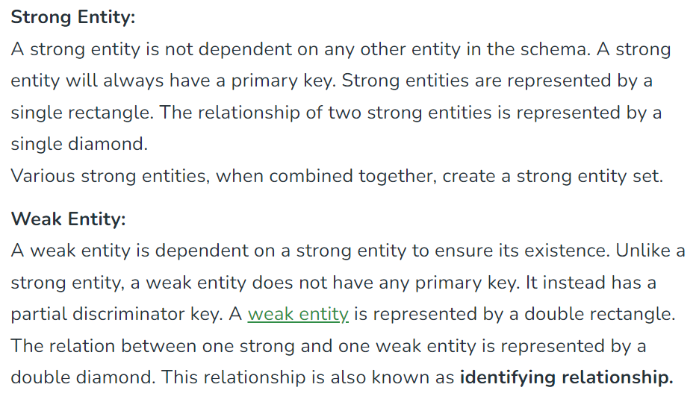
Difference between weak entity set and strong entity set.

Slide 68
What is Nested query?
A nested query is a query that has another query embedded within it. The embedded query is called a subquery. A subquery typically appears within the WHERE clause of a query. It can sometimes appear in the FROM clause or HAVING clause.

Slide 69
List out different types of Join Operators?
Inner Join
Outer join
  Left outer join,
  Right outer join,
  Full outer join.

Slide 70
Define Functional Dependency?
The functional dependency is a relationship that exists between two attributes. It typically exists between the primary key and non-key attribute within a table.
X→Y
The left side of FD is known as a determinant, the right side of the production is known as a dependent.

Slide 71
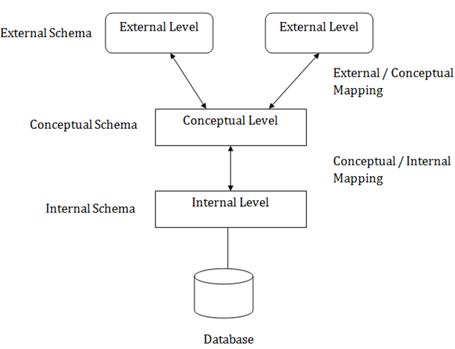
Describe 3 level schema architecture. Why do we need mappings between schema levels?
Internal level: It has an internal schema to describes the physical storage structure of data base, complete details of data storage and access path for database.
Conceptual level: It describes the structure of whole database for a community of users. It hides the details of physical storage structure and describes entities, data types and relationships.
Eternal or view level: It describes the part of database in a particular user group.

Slide 72
PART – B: Describe 3 level schema architecture. Why do we need mappings between schema levels?
This structure is used to visualise the schema levels very conveniently. on the basis of this schema structure each user group has its own external schema.So that DBMS transform request on an external schema and request against conceptual schema and internal schema for processing the stored database.This process is called mappings.this is time consuming process.

Slide 73
Entity: An entity is an object, thing or placed which are distinguished from each other with the set of features it had. In DBMS, it is a relation which will be stored with its features to identify them.
Participation Constraint: The participation constraint specifies the number of instances of an entity can participate in a relationship set.

Slide 74
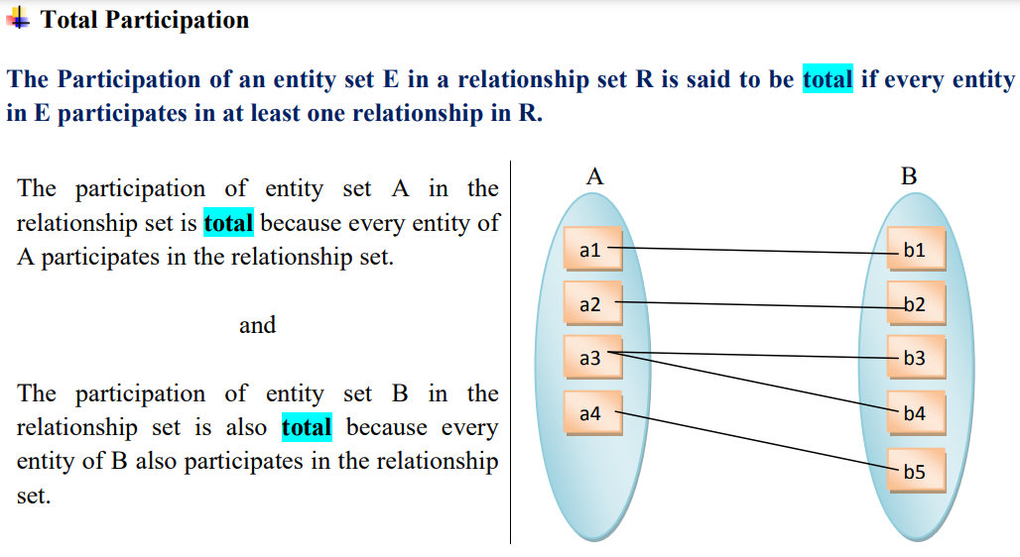
Total Participation

Slide 75
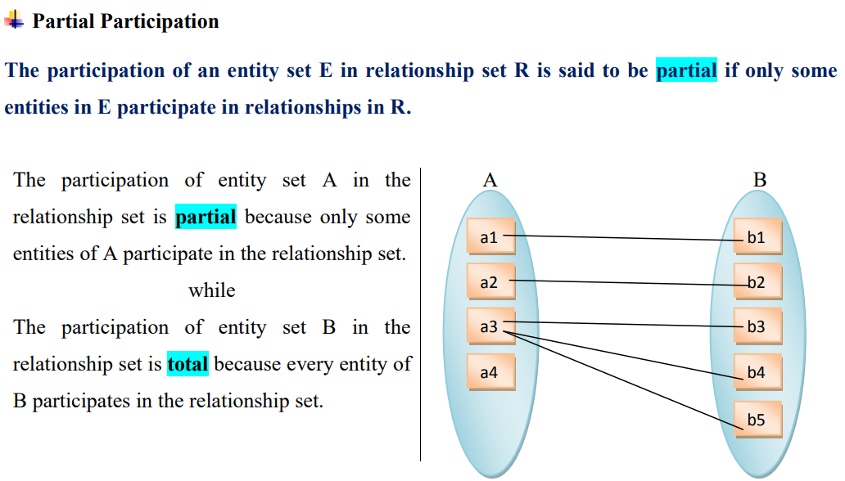
Partial Participation

Slide 76
Cardinality Ratio: the cardinality ratio tells the number of entities to which another entity can be associated via a relationship set.
Descriptive attribute: Like entities, a relationship too can have attributes. These attributes are called descriptive attributes.

Slide 77
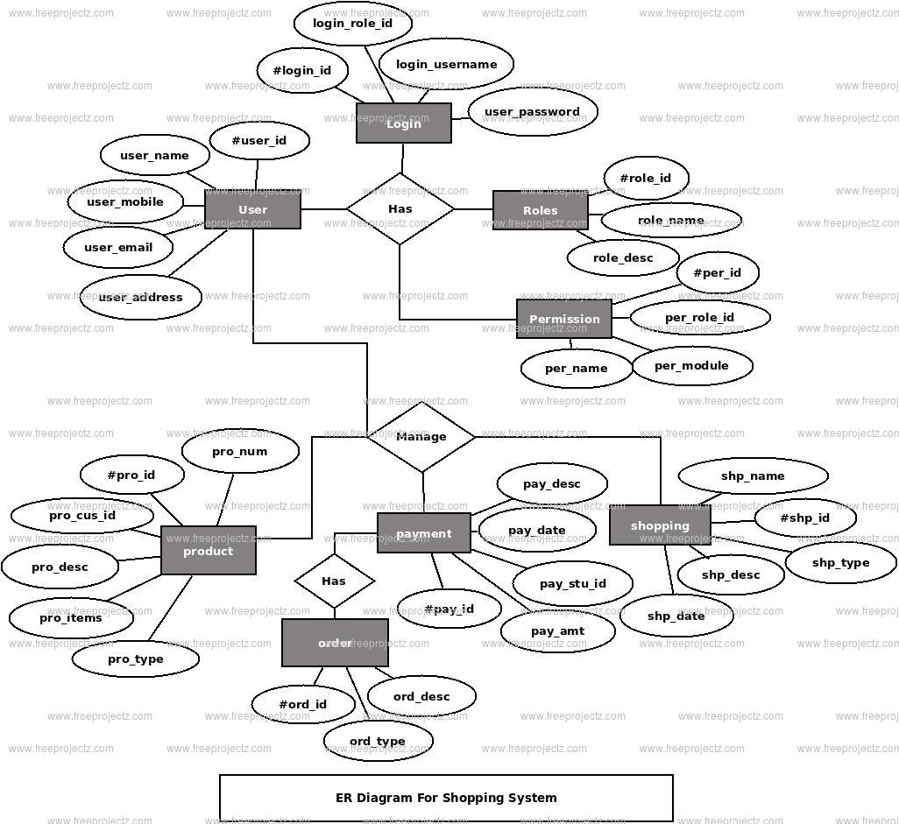
7a. E-R diagram for online shopping system.

Slide 78
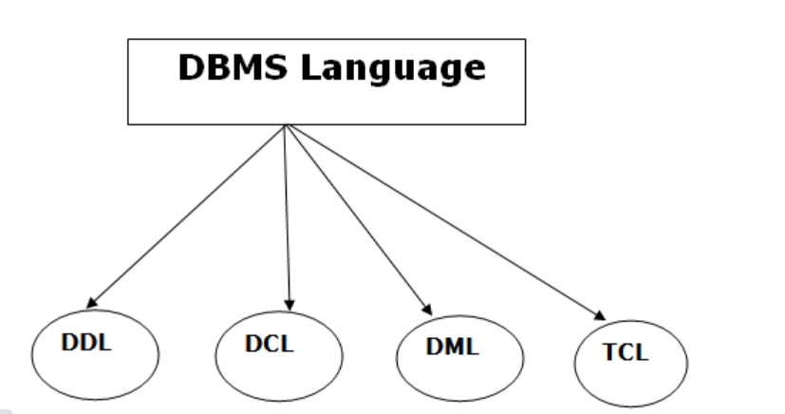
7b. Explain database languages

Slide 79
DDL
Data Definition Language (DDL)
DDL stands for Data Definition Language. It is used to define database structure or pattern.
It is used to create schema, tables, indexes, constraints, etc. in the database.
Using the DDL statements, you can create the skeleton of the database.
Data definition language is used to store the information of metadata like the number of tables and schemas, their names, indexes, columns in each table, constraints, etc.

Slide 80
Example commands of DDL
Create: It is used to create objects in the database.
Alter: It is used to alter the structure of the database.
Drop: It is used to delete objects from the database.
Truncate: It is used to remove all records from a table.
Rename: It is used to rename an object.

Slide 81
DML
DML stands for Data Manipulation Language. It is used for accessing and manipulating data in a database. It handles user requests.
Here are some tasks that come under DML:
Select: It is used to retrieve data from a database.
Insert: It is used to insert data into a table.
Update: It is used to update existing data within a table.
Delete: It is used to delete all records from a table.

Slide 82
DCL
DCL stands for Data Control Language. It is used to retrieve the stored or saved data.
The DCL execution is transactional. It also has rollback parameters.
Here are some tasks that come under DCL:
Grant: It is used to give user access privileges to a database.
Revoke: It is used to take back permissions from the user.

Slide 83
TCL
TCL is used to run the changes made by the DML statement. TCL can be grouped into a logical transaction.
Here are some tasks that come under TCL:
Commit: It is used to save the transaction on the database.
Rollback: It is used to restore the database to original since the last Commit.

Slide 84

SQL Query

Slide 85
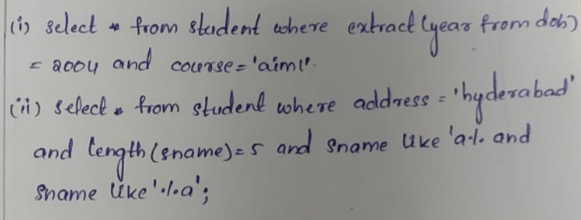
Solutions

Slide 86
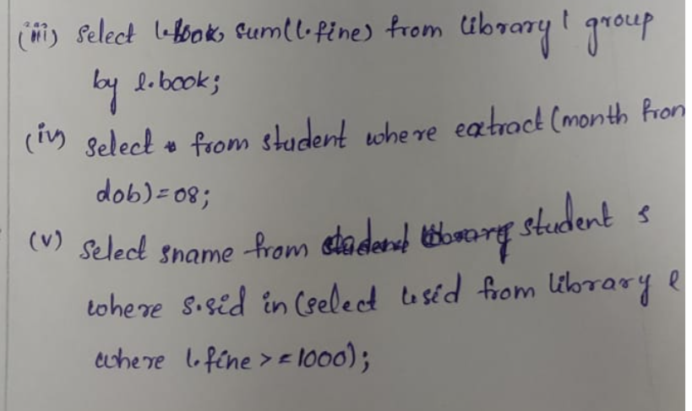
Solutions

Slide 87
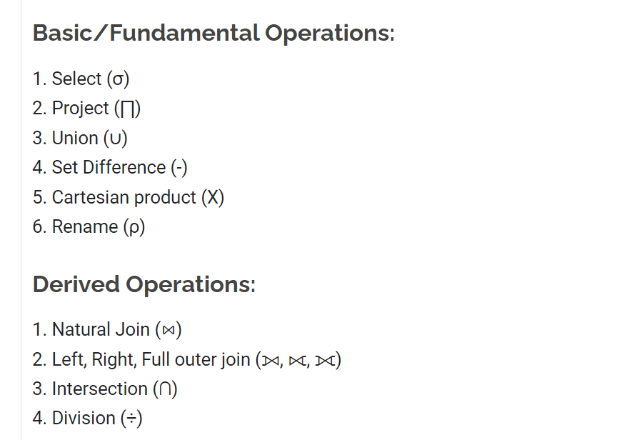
Relation Algebra operations

Slide 88
INTRODUCTION TO SCHEMA REFINEMENT
Problems Caused by Redundancy
Storing the same information redundantly, that is, in more than one place within a database, can lead to several problems:
Redundant storage: Some information is stored repeatedly.
Update anomalies: If one copy of such repeated data is updated, an inconsistency is created unless all copies are similarly updated.
Insertion anomalies: It may not be possible to store some information unless some other information is stored as well.
Deletion anomalies: It may not be possible to delete some information without losing some other information as well.
Slide No:L1-2

